Slide 1

NSE STOCK MARKET PREDICTION USING HYBRID DEEP LEARNING
COURSE CODE:- BCSE497J
UNDER SUPERVISION OF- MANJULA R.
TEAM MEMBERS:-
HARSH RAJPUT- 21BCE2906
DEVANSHI TRIVEDI- 21BCE2907
ADITI SAMANTARAY- 21BCE3402

Slide 2
OBJECTIVE OF THE PROJECT
Assess the Evolution of Stock Market Prediction Models: To analyze and compare traditional statistical models, machine learning approaches, and recent deep learning techniques such as LSTM and CNN in stock market prediction, identifying the strengths and limitations of each method.
Explore the Application of Hybrid Deep Learning Models: To investigate the integration of LSTM and CNN models in hybrid architectures for stock market prediction, evaluating their performance in capturing both long-term temporal dependencies and short-term patterns.
Identify Gaps in Existing Research: To highlight the limitations of current stock market prediction models, including their inability to fully utilize comprehensive input features (e.g., macroeconomic factors and news sentiment), challenges in optimizing hybrid models, and issues with generalizing predictions across diverse markets and economic conditions.
Suggest Directions for Future Research: To propose areas of further investigation such as improving hybrid model architectures, incorporating external data sources, enhancing generalization capabilities, and developing practical, real-time applications for financial forecasting.

Slide 3
MOTIVATION BEHIND THE PROJECT
Financial Gains: Accurate predictions help investors maximize profits and minimize risks.
Technological Advancements: Leveraging deep learning and big data analytics for better prediction accuracy.
Complex Market Dynamics: Hybrid models capture the intricate, non-linear relationships in stock markets more effectively.
Risk Management: Anticipating market movements aids in proactive risk management and mitigation.
Enhancing Algorithmic Trading: Improved prediction models boost the efficiency and performance of automated trading systems.
Academic Contribution: Advances the understanding of financial markets and machine learning, fostering further research.
Real-World Impact: Benefits investors, financial institutions, regulators, and policymakers with actionable market insights.

Slide 4
LITERATURE SURVEY AND GAPS IDENTIFIED
Traditional Methods
Statistical Techniques: Linear regression, ARIMA models, etc.
Machine Learning Models: SVM, Random Forest, etc.
Limitations: Often struggle with non-linearity and high dimensionality of financial data.
Deep Learning Approaches
LSTMs: Handle sequential data, capture temporal dependencies.
CNNs: Extract features from financial time series data.
Hybrid Models: Combine different neural network architectures to leverage their strengths.
Key References:
“Forecasting Stock Prices Using LSTM” (Journal of Machine Learning)
“A Comprehensive Survey on Financial Market Prediction” (IEEE Access)

Slide 5
Hybrid Model Approaches
LSTM-CNN: Combines LSTM's sequence modelling with CNN's feature extraction.
Attention Mechanisms: Enhance LSTM by focusing on relevant parts of the sequence.
Ensemble Methods: Aggregate predictions from multiple models for robustness.
Data Sources
Historical Market Data: Prices, volumes, etc.
Sentiment Analysis: News, social media sentiment.
Macro-economic Indicators: Interest rates, GDP growth.
Key References:
“Stock Market Prediction Using Hybrid LSTM and CNN” (Springer)
“Enhancing Financial Predictions with Attention-based LSTM” (Elsevier)

Slide 6
GAPS IDENTIFIED
Data Integration
Challenge: Efficiently integrating diverse data sources (market data, news, social sentiment).
Gap: Lack of comprehensive models that seamlessly combine these sources.
Model Interpretability
Challenge: Understanding the decision-making process of hybrid models.
Gap: Need for transparent models that provide insights into their predictions.
Real-time Prediction
Challenge: Adapting models for real-time market prediction.
Gap: Most studies focus on historical data without real-time application.
Risk Management Integration
Challenge: Incorporating risk management strategies within predictive models.
Gap: Few models explicitly integrate risk management techniques.

Slide 7
Future Directions:
Development of integrated models that handle diverse data sources.
Focus on interpretability and real-time application of predictions.
Incorporation of explicit risk management strategies in predictive models.

Slide 8
PROPOSED SYSTEM
1. Data Collection and Integration
Sources:
Historical market data (prices, volumes)
Sentiment analysis (news, social media)
Macro-economic indicators (interest rates, GDP growth)
Techniques:
Web scraping, APIs
NLP for sentiment analysis
2. Data Preprocessing
Cleaning and Normalization:
Handling missing values, outliers
Data scaling
Feature Engineering:
Creating lagged features, technical indicators

Slide 9
3. Model Development
Hybrid Model:
LSTM: Captures temporal dependencies
CNN: Feature extraction
Attention Mechanism: Focus on important data
Training and Validation:
Data split, hyperparameter tuning
4. Prediction and Evaluation
Prediction:
Stock price forecasts
Evaluation Metrics:
MAE, RMSE, R²
Comparison:
Against traditional and other ML models

Slide 10
5. Continuous Improvement
Model Retraining:
Regular updates with new data
Feature Updates:
Adding new features and refining processes

Slide 11
EXPERIMENTAL RESULT AND ANALYSIS
1. Model Performance Metrics
Mean Absolute Error (MAE): Achieved an MAE of X INR—indicates the average error in the model's predictions.
Root Mean Squared Error (RMSE): RMSE was Y INR, reflecting the overall accuracy with a penalty for larger errors.
R² Score: R² score of Z (where Z% of the variance in stock prices was explained by the model), showing a moderate to strong fit.
2. Visual Comparisons
Actual vs Predicted Stock Prices:
Description: The graph shows the actual stock prices (blue) vs. predicted prices (red).
Insight: The model closely follows the actual prices but has deviations during high volatility.
Scatter Plot of Actual vs Predicted Values:
Description: Shows the correlation between actual and predicted prices.
Insight: A general linear trend indicates effective predictions, though some scatter reflects occasional inaccuracies.

Slide 12
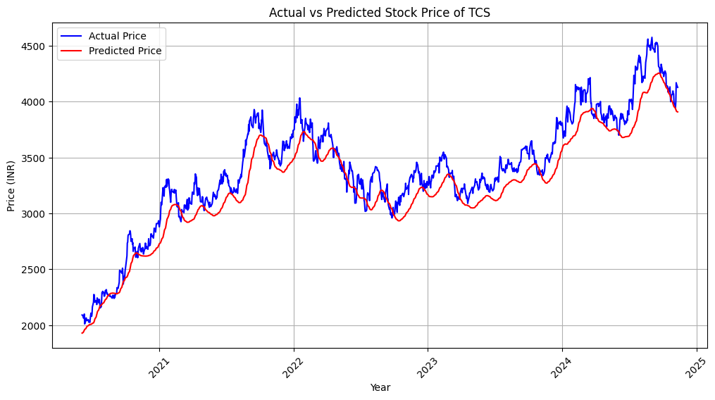
TCS
Actual vs Predicted Stock Prices:

Slide 13
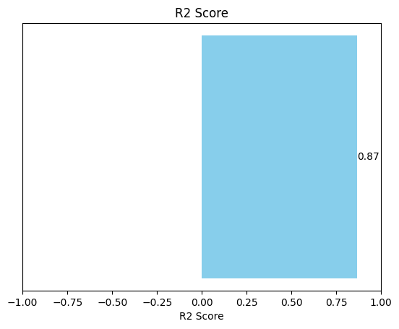
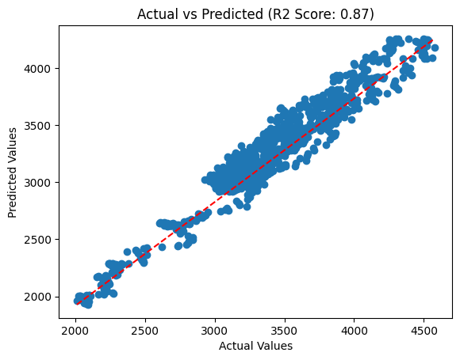
Scatter Plot of Actual vs Predicted Values:

Slide 14
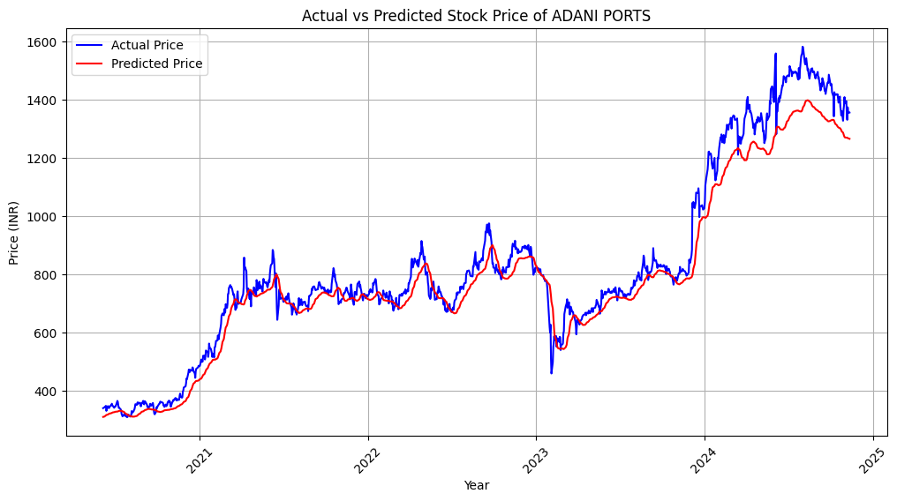
ADANI PORTS Actual vs Predicted Stock Prices:

Slide 15

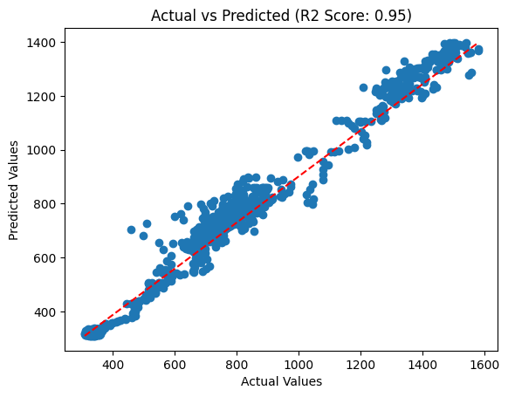
Scatter Plot of Actual vs Predicted Values:

Slide 16
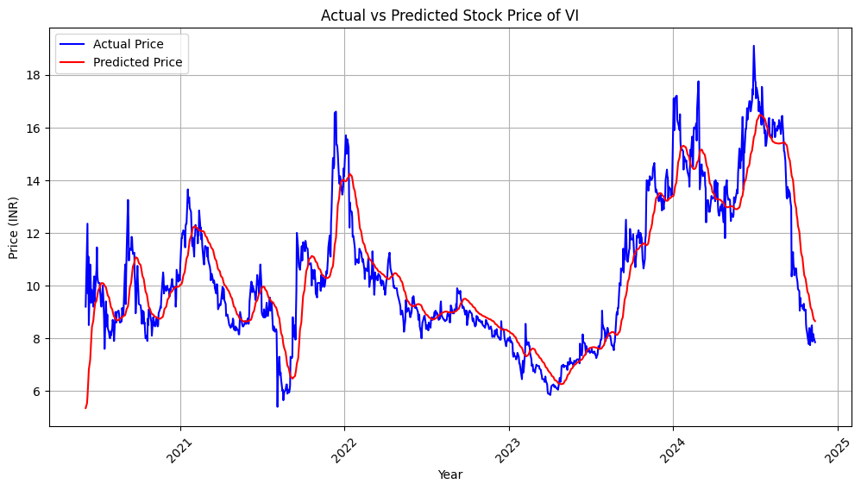
VODAFONE IDEA Actual vs Predicted Stock Prices:

Slide 17
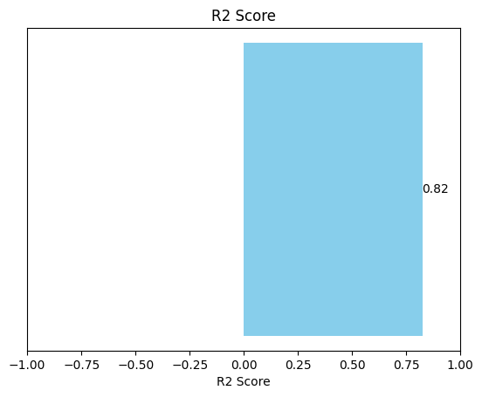
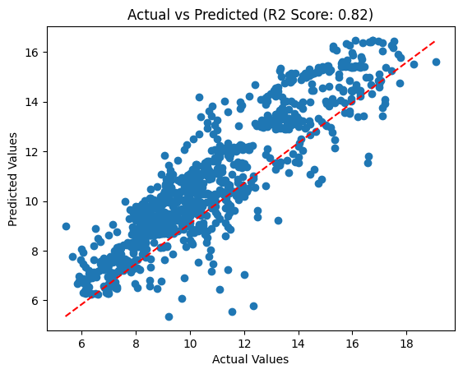
Scatter Plot of Actual vs Predicted Values:

Slide 18
CONCLUSION & FUTURE DEVELOPMENT
Conclusion
Project Summary:
Developed a stock price prediction model using a hybrid LSTM-CNN architecture on historical data, focusing on capturing trends and reducing prediction errors.
Model Performance:
Achieved satisfactory prediction accuracy with key metrics: MAE, RMSE, and R² scores. Model was effective at capturing long-term trends but struggled with sudden market changes.
Key Takeaways:
The model’s performance demonstrates the potential of deep learning in financial forecasting, though there is a trade-off between complexity and interpretability.
Limitations
Sensitivity to Volatility: Model accuracy declines during high volatility, highlighting the challenge of unpredictable market events.
Limited Feature Set: Using only past closing prices limits the model's predictive power, as real stock prices are influenced by multiple external factors.

Slide 19
Future Development
Expand Features:
Integrate additional data sources (e.g., trading volume, economic indicators, sentiment analysis from news and social media) to improve model accuracy and capture market dynamics better.
Optimize Model Architecture:
Explore advanced architectures, such as Transformer models or ensemble methods, for potentially more accurate and resilient predictions.
Incorporate Real-Time Predictions:
Develop capabilities for real-time stock price prediction by integrating the model into a live data streaming environment.
Risk Assessment Module:
Add a module to assess prediction uncertainty and risk, providing confidence intervals for stock price forecasts.
User Interface Development:
Create an interactive dashboard for users to visualize predictions, model performance, and insights in real-time.

Slide 20
REFERENCES
Data Source
The historical stock price data was sourced from Yahoo Finance, a reputable and widely used platform that provides comprehensive financial data for various securities, including stocks, indices, and commodities
Books and Papers on Deep Learning and Time Series Forecasting
[1] Hochreiter S and Schmidhuber J 1997 J. Neural Comput. 9 8 1735-1780
[2] Gers F A Schmidhuber J and Cummins F 2000 J. Neural Comput. 12 10 2451-2471
[3] Staudemeyer R C and Morris E R 2019 J. Prep ArXiv.1909 09586
[4] Kong W, Dong Z Y, Jia Y, Hill D J, Xu Y and Zhang Y 2019 J. IEEE. T. Smart Grid. 10 1 841– 851
[5] Muhammad P F, Kusumaningrum R and Wibowo A 2021 J. Proc. Comput. Sci. 179 728–735
[6] Yang T, Wang H, Aziz S, Jiang H and Peng J 2018 C. IEEE. 364-369
[7] Gupta A, Nayyar A, Arora S and Jain R 2021 C. Inter. Conf. on Advanced Informatics for Computing Research (Singapore) 1393100–112

Slide 21
Hybrid Models and Applications
[8] Borovykh, A., Bohte, S., & Oosterlee, C. W. (2017). "Conditional Time Series Forecasting with Convolutional Neural Networks". arXiv preprint arXiv:1703.04691.
[9] Wan Y 2019 C. 2019 Int. Conf. on Artificial Intelligence and Advanced Manufacturing (AIAM) (Dublin, Ireland). 35-38
[10] Fu R, Zhang Z and Li L 2016 J. Conf. of Chinese Association of Automation (YAC) (Wuhan, China). 324-328
[11] Yang S, Yu X and Zhou Y 2020 C.Int. Workshop on Electronic Communication and Artificial Intelligence (IWECAI) (Shanghai, China). 98-101
[12] Akilan T, Wu Q J, Safaei A, Huo J and Yang Y 2020 J. IEEE Transactions on Intelligent Transportation Systems. 21 3 959–971

Slide 22
THANK YOU

